Slide 1
Binary SEARCH Tree
Session 11-12
Elizabeth Paskahlia Gunawan, S.Kom., M.Cs

Slide 2
Learning outcomes
Session 11-12
The learning outcomes associated with this topic:
LO 1: Explain the concept of data structures and its usage in Computer Science
LO 2: Illustrate any learned data structure and its usage in application
LO 3: Apply data structures using C

Slide 3
Learning outcomes
Session 11-12
At the end of this session, students will be able to:
Explain the concept of Binary Search Tree and its operations.
Apply Binary Search Tree using C.

Slide 4
Subtopics
Session 11-12
Binary Search Tree
Binary Search Tree Operations
Program Example

Slide 5
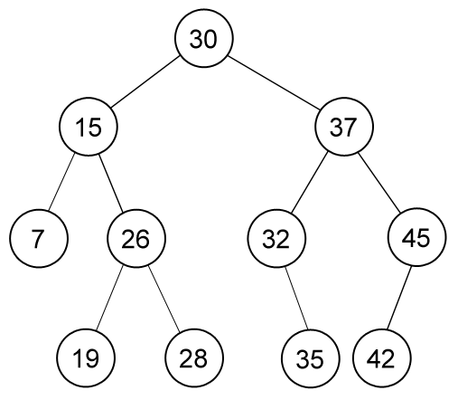
Binary Search Tree
Binary Search Tree (BST) is one such data structures that supports faster searching, rapid sorting, and easy insertion and deletion
BST is also known as sorted versions of binary tree
For a node x in of a BST T,
the left subtree of x contains elements that are smaller than those stored in x,
the right subtree of x contains all elements that are greater than those stored in x,
with the assumptions that the keys are distinct

Slide 6
Binary Search Tree Operations
Binary Search Tree has the following basic operations:
find(x) : find key x in the BST
insert(x) : insert new key x into BST
remove(x) : remove key x from BST

Slide 7
Binary Search Tree Operations
Operations: Search
Because of the property of BST, finding/searching in BST is easy.
Let the key that we want to search is X.
We begin at root
If the root contains X then search terminates successfully.
If X is less than root’s key then search recursively on left sub tree, otherwise search recursively on right sub tree.

Slide 8
Binary Search Tree Operations
Operations: Search
Because of the property of BST, finding/searching in BST is easy.
struct node* search (struct node *curr, int X) {
if ( curr == NULL ) return NULL;
// X is found
if ( X == curr->data ) return curr;
// X is located in left sub tree
if ( X < curr->data ) return find(curr->left, X);
// X is located in right sub tree
return find(curr->right, X);
}

Slide 9
Binary Search Tree Operations
Operations: Insertion
Inserting into BST is done recursively.
Let the new node’s key be X,
We begin at root
Validate if X is already present in the tree, as having duplicate values with separate nodes in BST makes no sense at all.
If X is less than node’s key then insert X into left sub tree, otherwise insert X into right sub tree
Repeat until we found an empty node to put X (X will always be a new leaf)

Slide 10
Binary Search Tree Operations
Operations: Insertion
Algorithm:
IF TREE = NULL THEN
Allocate memory for TREE
SET TREE->DATA = VAL
SET TREE->LEFT = TREE ->RIGHT = NULL
ELSE IF TREE->DATA != VAL THEN
IF VAL < TREE->DATA
Insert(TREE->LEFT, VAL)
ELSE
Insert(TREE->RIGHT, VAL)
[END OF IF]
[END OF IF]

Slide 11
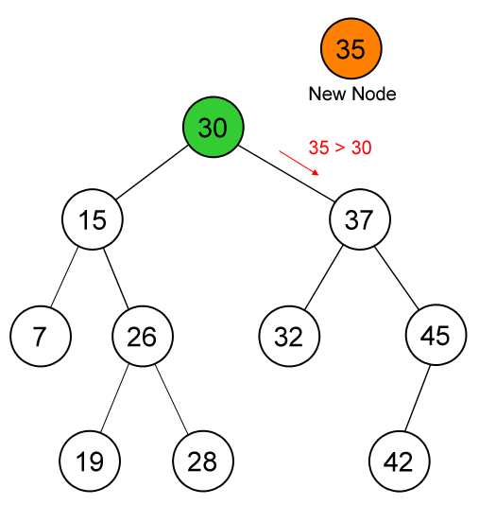
Binary Search Tree Operations
Operations: Insertion – Example
Inserting new key (35)

Slide 12
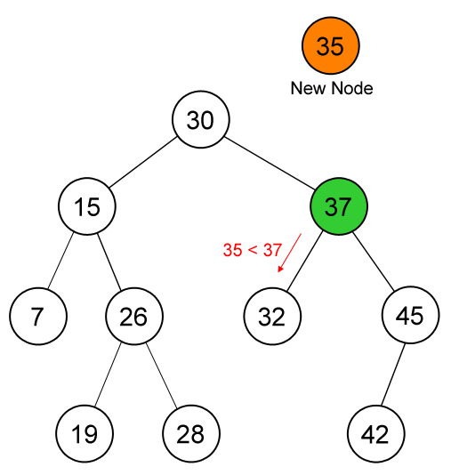
Binary Search Tree Operations
Operations: Insertion – Example
Inserting new key (35)

Slide 13
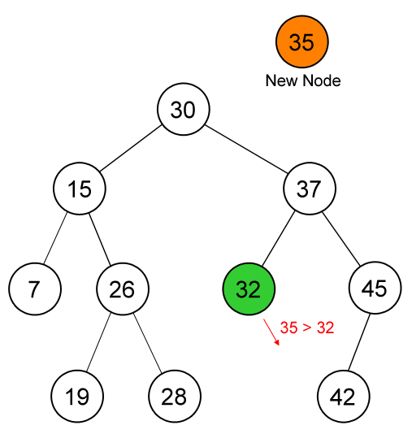
Binary Search Tree Operations
Operations: Insertion – Example
Inserting new key (35)

Slide 14
Binary Search Tree Operations
Operations: Insertion – Example
Inserting new key (35)

Slide 15
Binary Search Tree Operations
Operations: Deletion
IF TREE = NULL, then
Write “VAL not found in the tree”
ELSE IF VAL < TREE->DATA
Delete(TREE->LEFT, VAL)
ELSE IF VAL > TREE->DATA
Delete(TREE->RIGHT, VAL)
ELSE IF TREE->LEFT AND TREE->RIGHT (2 CHILD)
SET TEMP = findLargestNode(TREE->LEFT)
SET TREE->DATA = TEMP->DATA
Delete(TREE->LEFT, TEMP->DATA)
ELSE
SET TEMP = TREE
IF TREE->LEFT = NULL AND TREE ->RIGHT = NULL (NO CHILD)
SET TREE = NULL
ELSE IF TREE->LEFT != NULL (1 CHILD)
SET TREE = TREE->LEFT
ELSE
SET TREE = TREE->RIGHT
FREE TEMP
Algorithm:

Slide 16
Binary Search Tree Operations
Operations: Deletion
There are 3 cases which should be considered:
If the key is in a leaf: Just delete that node
If the key is in a node which has one child: Delete that node and connect its child to its parent
If the key is in a node which has two children: Find the right most child of its left sub tree (Predecessor -> Node P), Replace the key with P’s key and remove P recursively. or alternately you can choose the left most child of its right sub tree (Successor)

Slide 17
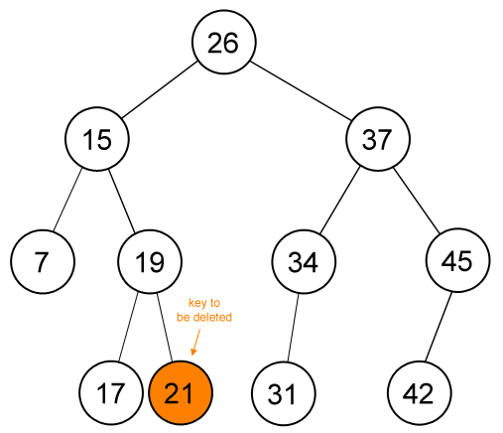
Binary Search Tree Operations
Operations: Deletion – Example
Case 1 21 is in a leaf, just delete that node
Deleting key (21)

Slide 18
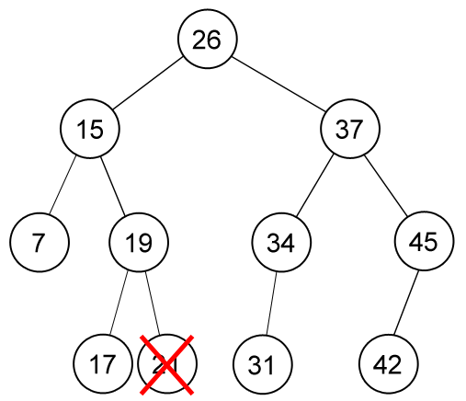
Binary Search Tree Operations
Operations: Deletion – Example
Case 1 21 is in a leaf, just delete that node
Deleting key (21)

Slide 19
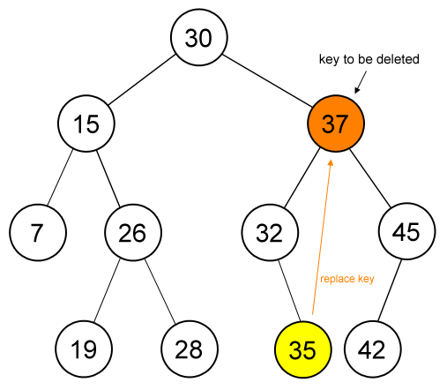
Binary Search Tree Operations
Operations: Deletion – Example
Case 3, Then Case 1 37 has 2 children, find the predecessor (35), replace 37 with 35, and delete 35. Because 35 has no child, then just delete it (Case 1).
Deleting key (37)

Slide 20
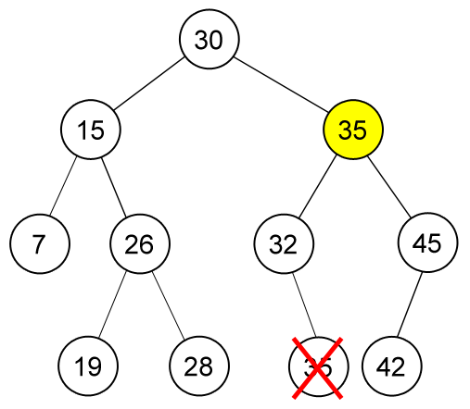
Binary Search Tree Operations
Operations: Deletion – Example
Case 3, Then Case 1 37 has 2 children, find the predecessor (35), replace 37 with 35, and delete 35. Because 35 has no child, then just delete it (Case 1).
Deleting key (37)

Slide 21
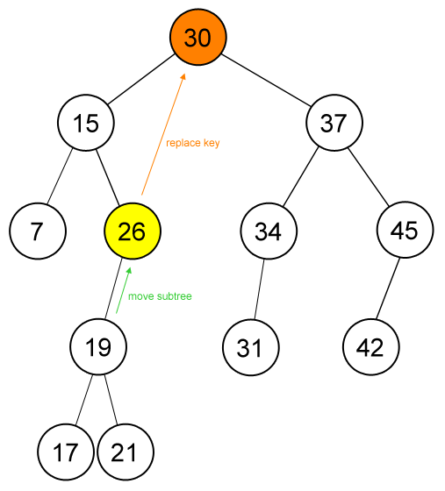
Binary Search Tree Operations
Operations: Deletion – Example
Case 3, Then Case 2 30 has 2 children, find its predecessor (26), replace 30 with 26, and delete 26. 26 has 1 child (Case 2), so delete the node and connect the child (19) to its parent (26).
Deleting key (30)

Slide 22
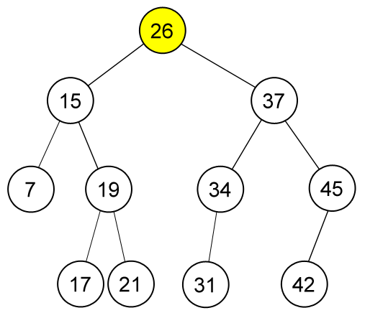
Binary Search Tree Operations
Operations: Deletion – Example
Case 3, Then Case 2 30 has 2 children, find its predecessor (26), replace 30 with 26, and delete 26. 26 has 1 child (Case 2), so delete the node and connect the child (19) to its parent (26).
Deleting key (30)

Slide 23
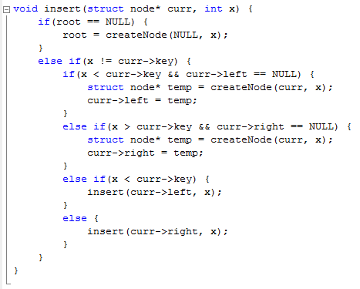
Program Example

Slide 24
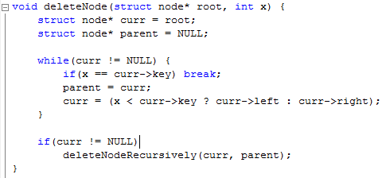
Program Example

Slide 25
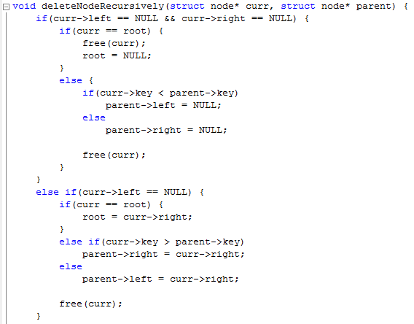
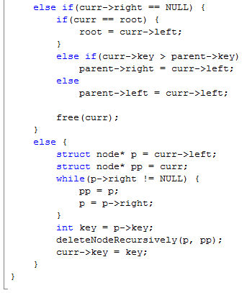
Program Example

Slide 26
References
S. Sridhar. 2015. Design and Analysis of Algorithms. Oxford University Press. New Delhi. ISBN: 9780198093695. Chapter 6
Reema Thareja. 2014. Data structures using C. Oxford University Press. New Delhi. ISBN:9780198099307. Chapter 10
Thomas H. Cormen, Charles E. Leiserson, Ronald L. Rivest, & Clifford Stein. (2009). Introduction to Algorithms. 03. The MIT Press. London. ISBN: 9780262033848. Chapter 12
Binary Search Tree, https://visualgo.net/bn/bst?slide=1

